Slide 1
Discussion Unit: DSE Analytics
DSE Analytics History Server
DSE Analytics Spark Job Server
Not: DSE Always-on SQL (another unit)
Other (sub-servers)
Notes:
The goal of this Discussion Unit is to configure and use DSE Analytics History Server, and DSE Analytics Spark Job Server.

Slide 2
Discussion Lab:
DSE Analytics; Process Architecture, and reporting on same
Matching pairs – Match the attributes on the right with the areas on the left
Notes:
On the next page we enter a Discussion Lab.

Slide 3


DSE Analytics: Process Architecture
Master
Has most info about your app
Logger
Persistent
Executor
Goes away
Driver
Some-Host:7080
Worker
Some-Host:4040
Notes:
Matching pairs Discussion Lab: Process Architecture
Match the terms on the right with the objects on the left.

Slide 4
End of Discussion Lab:
Notes:
End of Discussion Lab-

Slide 5
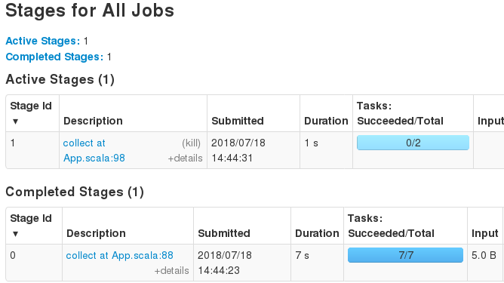
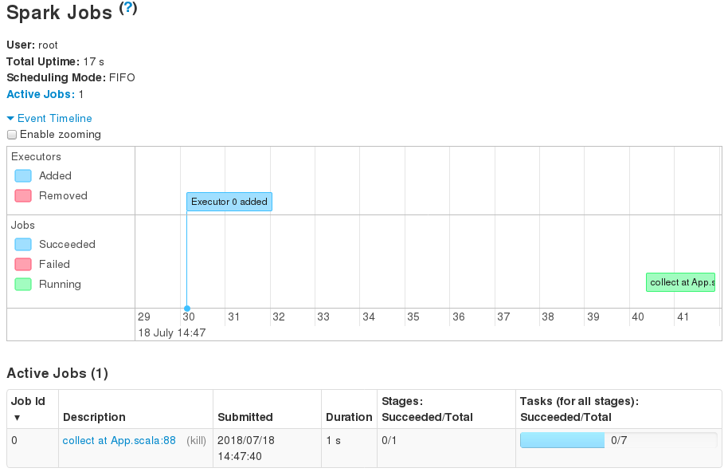
While a DSE Analytics App is Running:
Notes:
While a DSE Analytics application is running, most information is available via the (Spark Master) Web UI, including a link to the application driver, with its data.

Slide 6
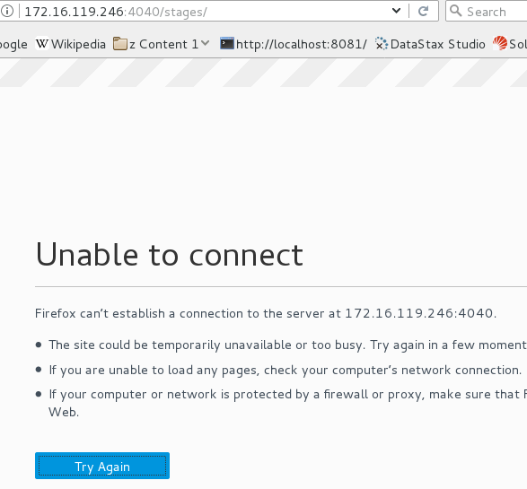
After a DSE Analytics App is Complete:
Notes:
After the DSE Analytics application terminates, the driver is terminated, and all of its data is lost.

Slide 7
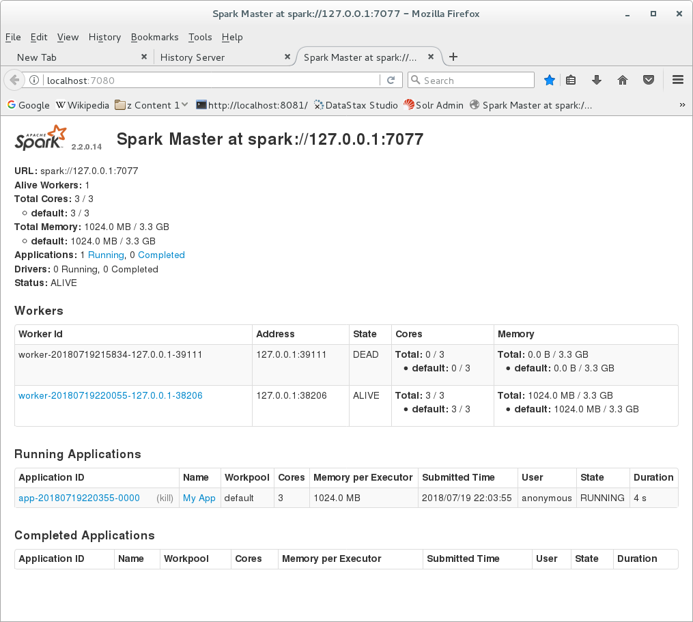
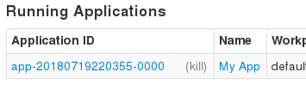

After a DSE Analytics App is Complete:
Notes:
After the DSE Analytics application terminates, the driver is terminated, and all of its data is lost.

Slide 8
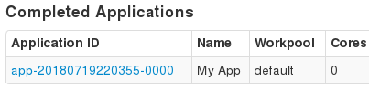


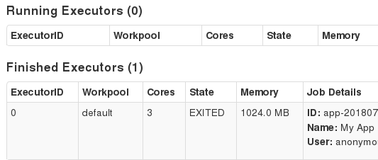
After a DSE Analytics App is Complete:
Notes:
There is very minimal data about the executors; nothing terribly useful.

Slide 9
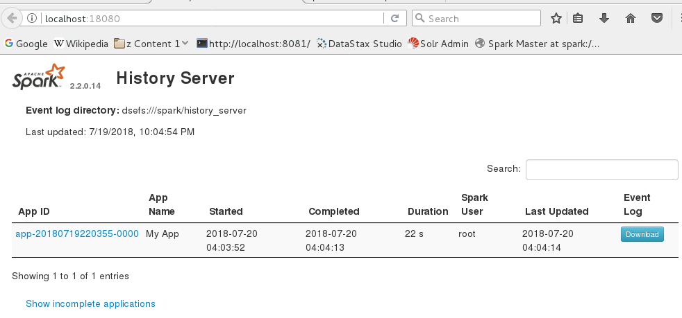
DSE Analytics History Server:
Notes:
The DSE Analytics History Server addresses this issue; presenting data about the DSE Analytics Application similar to that as available when the application is still running.
Reference Urls:
https://docs.datastax.com/en/dse/6.0/dse-dev/datastax_enterprise/spark/sparkConfiguringfHistoryServer.html

Slide 10
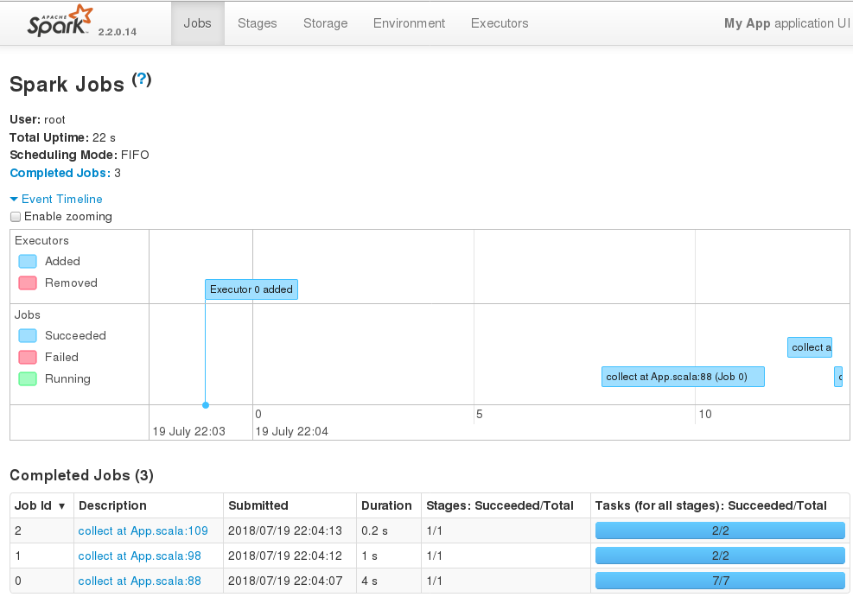
DSE Analytics History Server:
Notes:
The DSE Analytics History Server addresses this issue; presenting data about the DSE Analytics Application similar to that as available when the application is still running.

Slide 11
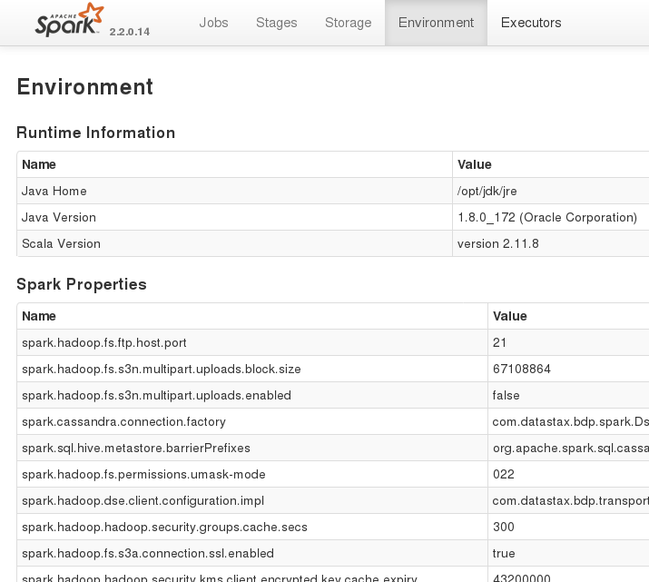
DSE Analytics History Server:
Notes:
The DSE Analytics History Server addresses this issue; presenting data about the DSE Analytics Application similar to that as available when the application is still running.

Slide 12
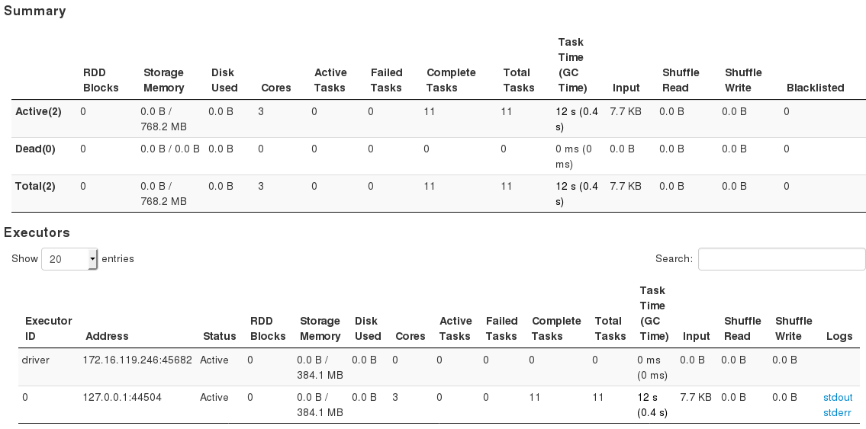
DSE Analytics History Server:
Notes:
The DSE Analytics History Server addresses this issue; presenting data about the DSE Analytics Application similar to that as available when the application is still running.

Slide 13
DSE Analytics History Server: How to
DSEFS
mkdir –p spark/history_server
spark-defaults.conf (40 lines, below are adds)
spark.eventLog.dir dsefs:///spark/history_server
spark.eventLog.enabled true
spark.history.fs.logDirectory dsefs:///spark/history_server
dse spark-history-server start|stop
localhost:18080
Notes:
To enable the DSE Analytics History Server:
Especially when multinode, create a directory on DSEFS, for use by the (history server).
Edit ./resources/spark/conf/spark-defaults.conf. 40 lines to begin with, every setting we discuss is an addition.
Reference Urls:
https://docs.datastax.com/en/dse/6.0/dse-dev/datastax_enterprise/spark/sparkConfiguringfHistoryServer.html

Slide 14

DSE Analytics History Server: Maintenance
spark-defaults.conf (more adds)
spark.history.fs.cleaner.enabled true
spark.history.fs.cleaner.interval 1d
spark.history.fs.cleaner.maxAge 7d
Notes:
Without the above setting, entries would only be added to the DSEFS directory; the settings above offers purge capability.

Slide 15
On DSEFS: (JSON formatted), avail from Web UI
dsefs dsefs://127.0.0.1:5598/spark/history_server/ > ls -l
Type Permission Owner Group Length Modified Name
file rwxrwx--- none none 98468 2018-07-19 22:04:14-0600 app-20180719220355-0000
Notes:
Data written to DSEFS is on JSON format, most of which is available via the (history server) Web UI.

Slide 16
DSE Analytics Spark Job Server
Notes:
Changing the discussion to the DSE Analytics Spark Job Server.

Slide 17
DSE Analytics Spark Job Server:
How you run (applications) now:
One of the REPLs
"dse spark-submit ... "
How OSS Spark also runs applications:
Spark REST Server
Deprecated in DSE 5.1
DSE Analytics Spark Job Server-
REST, Curl (no Bash required)
Faster/easier than spark-submit .. (Re-uses SparkContext)
Developers only, no HA
Notes:
No additional notes-

Slide 18
DSE Analytics Spark Job Server:
Simple Web UI, port 8090
Submit jobs via Curl
Query status, results via Curl
Query job history via Curl
Can cache/share RDDs across jobs
Notes:
No additional notes-

Slide 19
DSE Analytics Spark Job Server: Configuring
./resources/spark/spark-jobserver/
./dse.conf
./settings.sh
dse spark-jobserver start|stop
Tutorial on GitHub, Url on Notes page
Notes:
Reference Urls:
https://docs.datastax.com/en/dse/6.0/dse-dev/datastax_enterprise/spark/sparkJobserverOverview.html
https://github.com/retroryan/DataStaxPlatformTutorialsScala/tree/master/IntroSparkJobServer

Slide 20
End of Unit:
Notes:
End of Discussion Unit-

